Slide 1
AI Recruiter –Shortlist a Suitable Candidate for Specific Job Role
- By vaishnavi

Slide 2
INTRODUCTION
“Accelerating artificial intelligence(AI) capabilities will enable automation of some task that have long required human labor. These transformation will open up new opportunities for individuals, the economy, and society, but they have the potential to disrupt the current livelihoods of millions of Americans”
In large Organizations there will be huge no of job application. Conducting interviews for each and everyone is difficult task for humans.
So Idea is to Build a AI model for shortlist the candidates.
This will be helpful for HR to find a right candidate for specific position.

Slide 3
AI Recruitment Use
It is expected majority of ad buying and placement in the U.S will be automated.
Some parameters by which potential employees are judged include skill test, technical knowledge test etc.
Bots can be trained to assess their personality as well.
Xiobin is a example for this, Candidate can take the assessment prior to the interview. This can help employees weed out candidates that do not match their expectation.
A survey by CareerBuilder found out that, 41% of companies have lost at least $25,000 and 25% of companies have lost $50,000 all because of bad hire.

Slide 4
Companies will get a tons of potential candidates in a single day. Going through so many resumes in a day, its easy to leave room for human error. Using chatbot can save you lot of effort, and you will only have to interview the people who make it through the final screening.
In current COVID-19 situation company cannot come to the campus, they have to go for remote hiring technique where they can use chatbot.

Slide 5
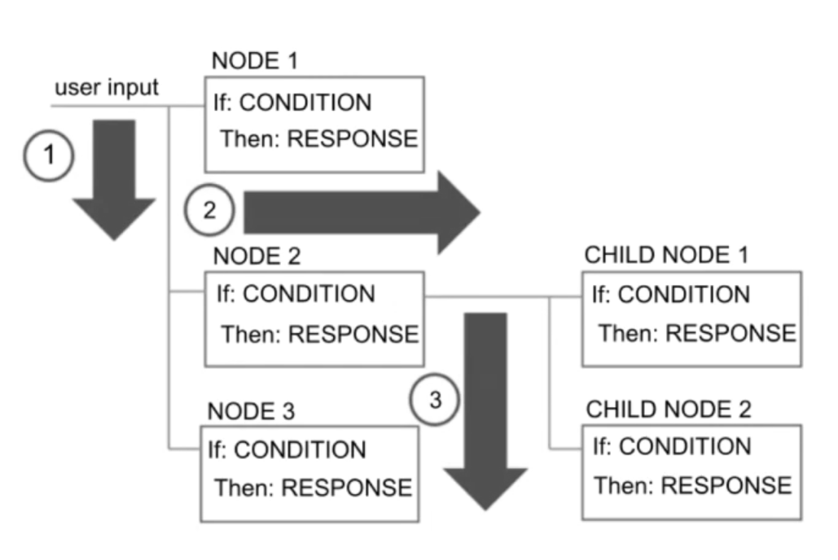
Flowchart and Implementation

Slide 6
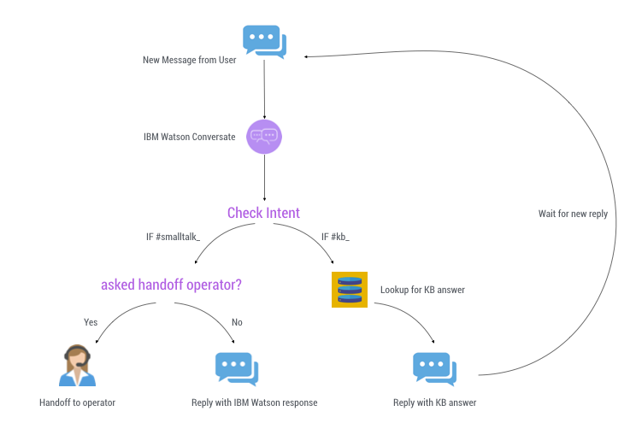

Slide 7


